Slide 1

问题的形式化描述
顾鹏 匡亚明学院
221240087

Slide 2
目录：
Q1：Subset Sum Problem (SSP)
Q2：k-Colorability Problem (k-COL)
Q3：Travelling Tournament Problem (TTP)
Q4：Maximum Diversity Problem (MDP)

Slide 3
Q1
问题引入：
The subset sum problem (SSP) is a decision problem in computer science. In its most general formulation, there is a multiset S of integers and a target-sum T, and the question is to decide whether any subset of the integers sum to precisely T. The problem is known to be NP-hard. Moreover, some restricted variants of it are NP-complete too.

Slide 4
Q1
形式化描述：
Input：A multiset S of integers and a target-sum T
Output: “Yes” if any subset of the integers sum to precisely T,
“No” otherwise

Slide 5
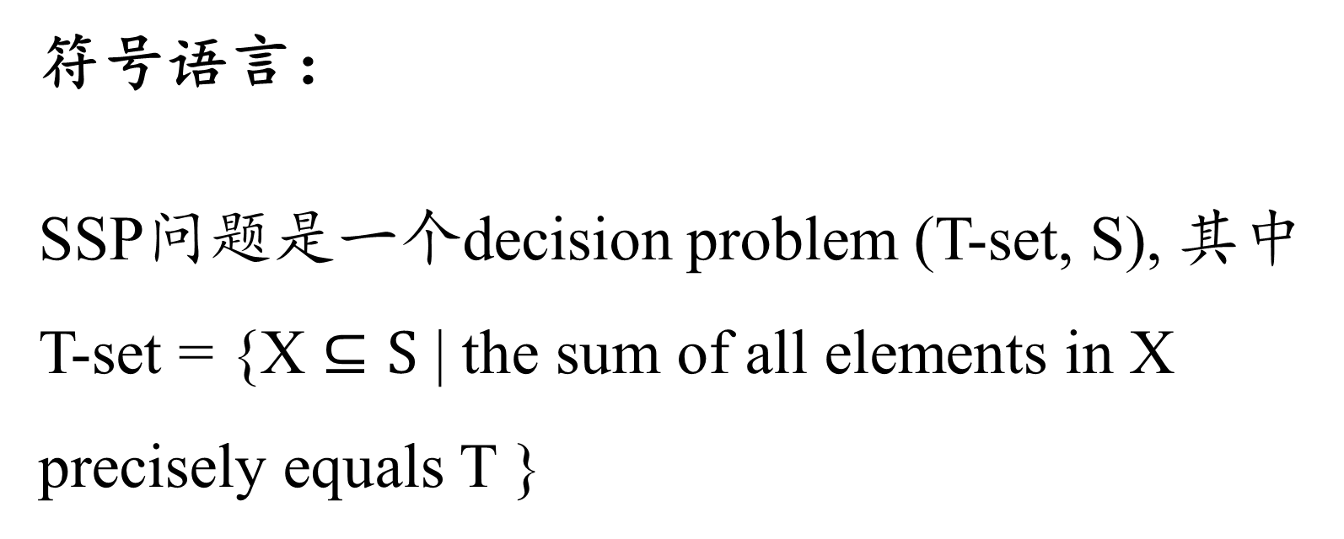
Q1
符号语言：
SSP问题是一个decision problem (T-set, S), 其中
T-set = {X $⊆S$ | the sum of all elements in X precisely equals T }

Slide 6
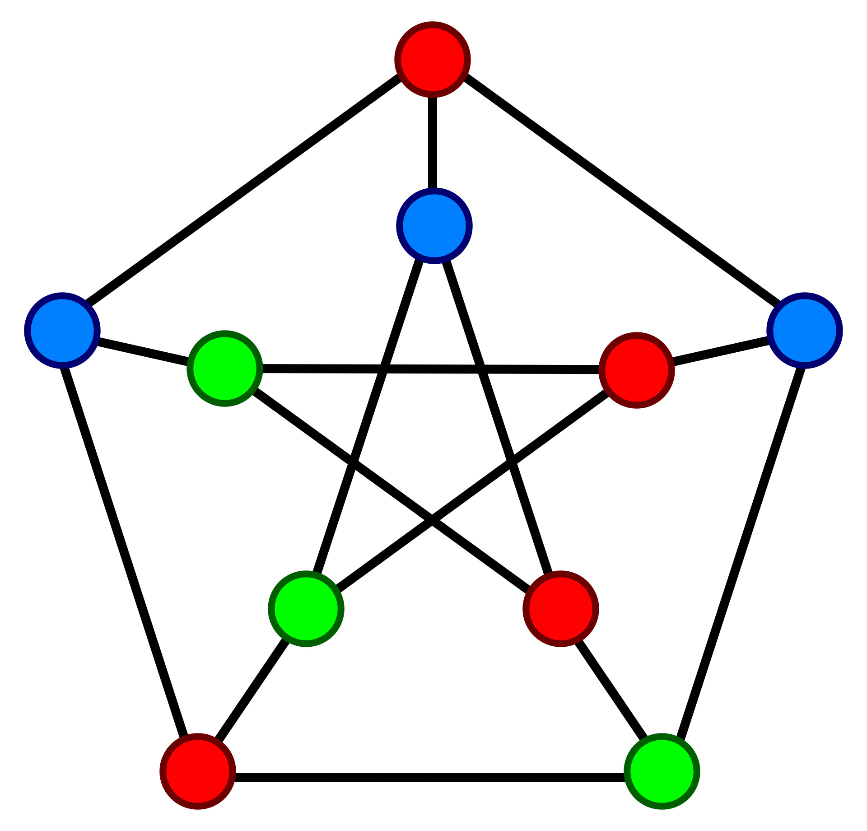
Q2
问题引入：
给定一个无向图，并给出不超过k种不同颜色，对图进行染色，判断是否可以使图中所有相邻顶点具有不同的颜色

Slide 7
Q2
形式化描述：
Input：An undirected graph G and an integer k
Output: “Yes” if all adjacent vertex pairs are different colors
dyed with no more than k different colors
“No” otherwise

Slide 8
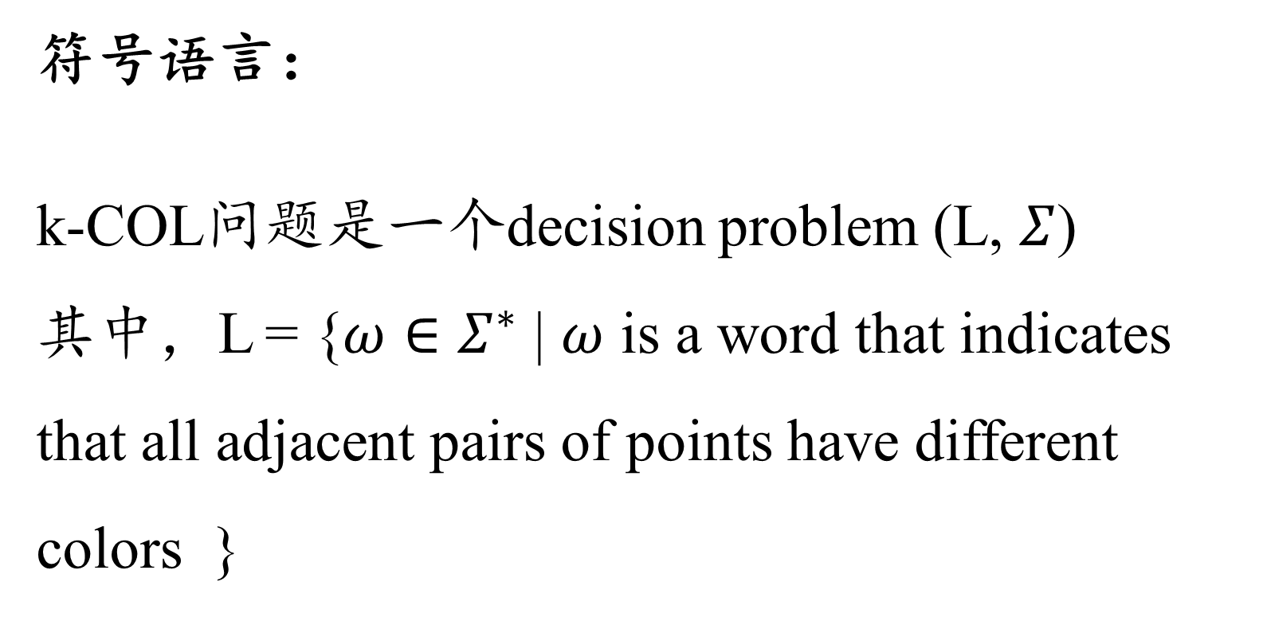
Q2
符号语言：
k-COL问题是一个decision problem (L, $Σ$)
其中，L = {$ω∈Σ^{∗}$ | $ω$ is a word that indicates that all adjacent pairs of points have different colors }

Slide 9

Q2
符号语言：
k-COL问题是一个decision problem (L, $Σ$)
其中， $Σ$ = {0, 1, …, k-1, #}
描述题目中的某种情况的方法为：
$a_{11}$ $a_{12}…$ $a_{1n}\#…\#a_{n1}…a_{nn}\#\#d_{1} d_{2}… d_{n}$

Slide 10
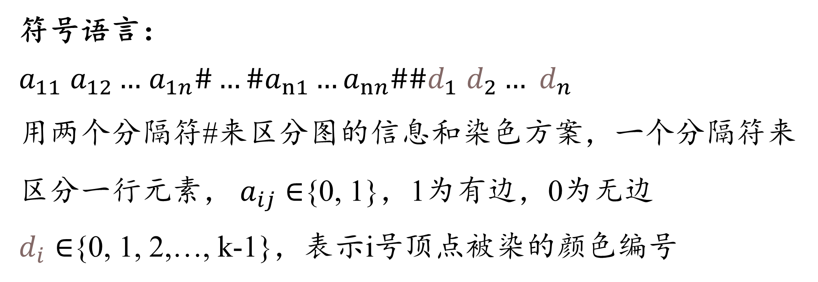
Q2
符号语言：
$a_{11}$ $a_{12}…$ $a_{1n}\#…\#a_{n1}…a_{nn}\#\#d_{1} d_{2}… d_{n}$
用两个分隔符#来区分图的信息和染色方案，一个分隔符来区分一行元素， $a_{ij}∈${0, 1}，1为有边，0为无边
$d_{i}∈${0, 1, 2,…, k-1}，表示i号顶点被染的颜色编号

Slide 11
Q3
问题引入：
问题的目标是为一组团队或选手安排比赛，以最小化他们的旅行成本或距离，同时确保每个团队或选手都有机会与其他团队或选手竞争。在实际TTP中，通常有一些约束条件，例如每支团队必须与其他团队比赛一定次数，或者比赛日程需要满足特定的时间窗口

Slide 12
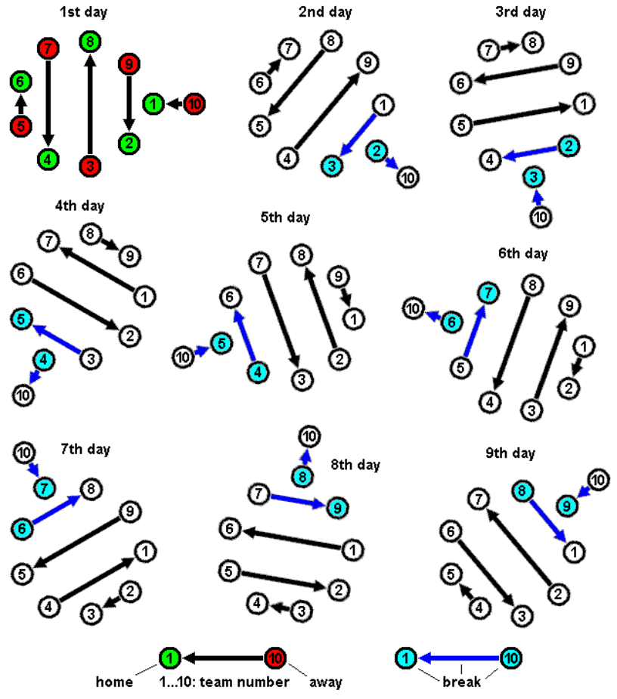
Q3
Round-robin tournament
是一种循环赛，其中每个参与队伍或选手都与其他参与者逐一比赛，并且分为主场(home)和客场(away)两种作战情况, 任何一支队伍与其他所有队伍需要进行两次作战，一次主场一次客场

Slide 13
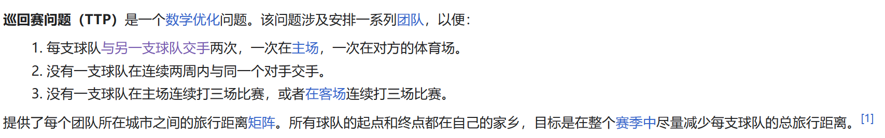
Q3
The Traveling Tournament Problem (TTP) addresses the problem
of minimizing the total travel distance in a double round robin
league tournament schedule where each team can play at most U
consecutive home and away matches
U是参数，看作这个问题的限制输入

Slide 14
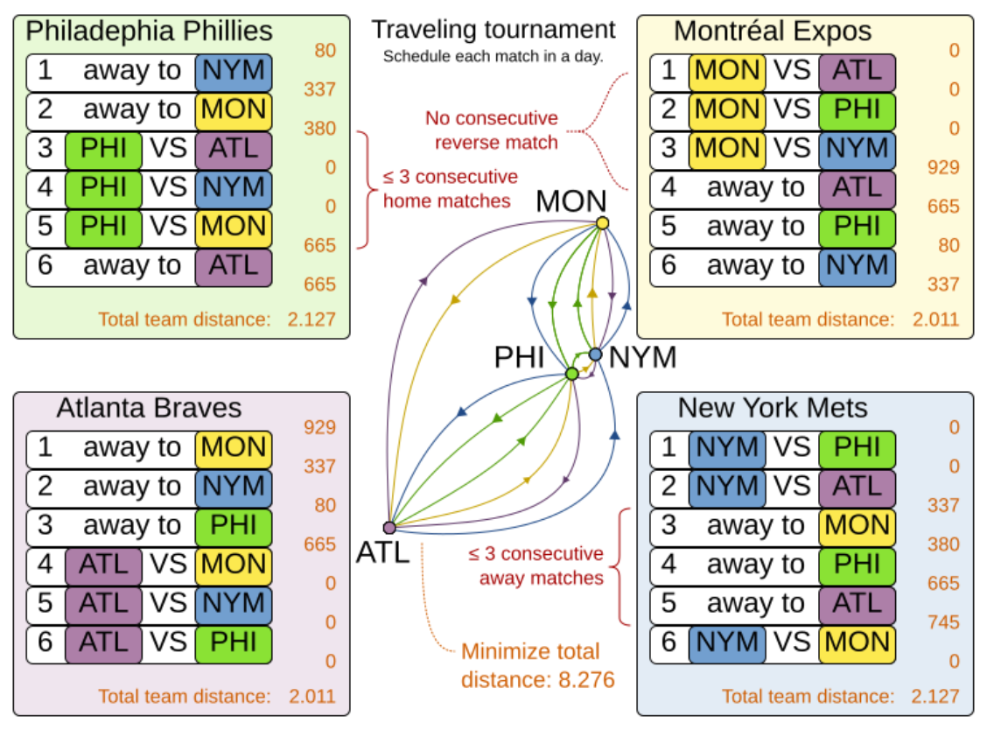
Q3

Slide 15

Q3
形式化描述：
Input: The number of teams n (n is even), and a distance matrix $D_{n×n}$
Constraints: For every input n and $D_{n×n}$, M(D, n) = {$P_{1}, P_{2},…,P_{2n−2}$};
The $P_{i}$ = {($h_{1},a_{1}$), ($h_{2},a_{2}$),…, ($h_{n/2},a_{n/2}$)}, of which (u, v) represents the game of u playing at home and v playing away in the i-th round

Slide 16
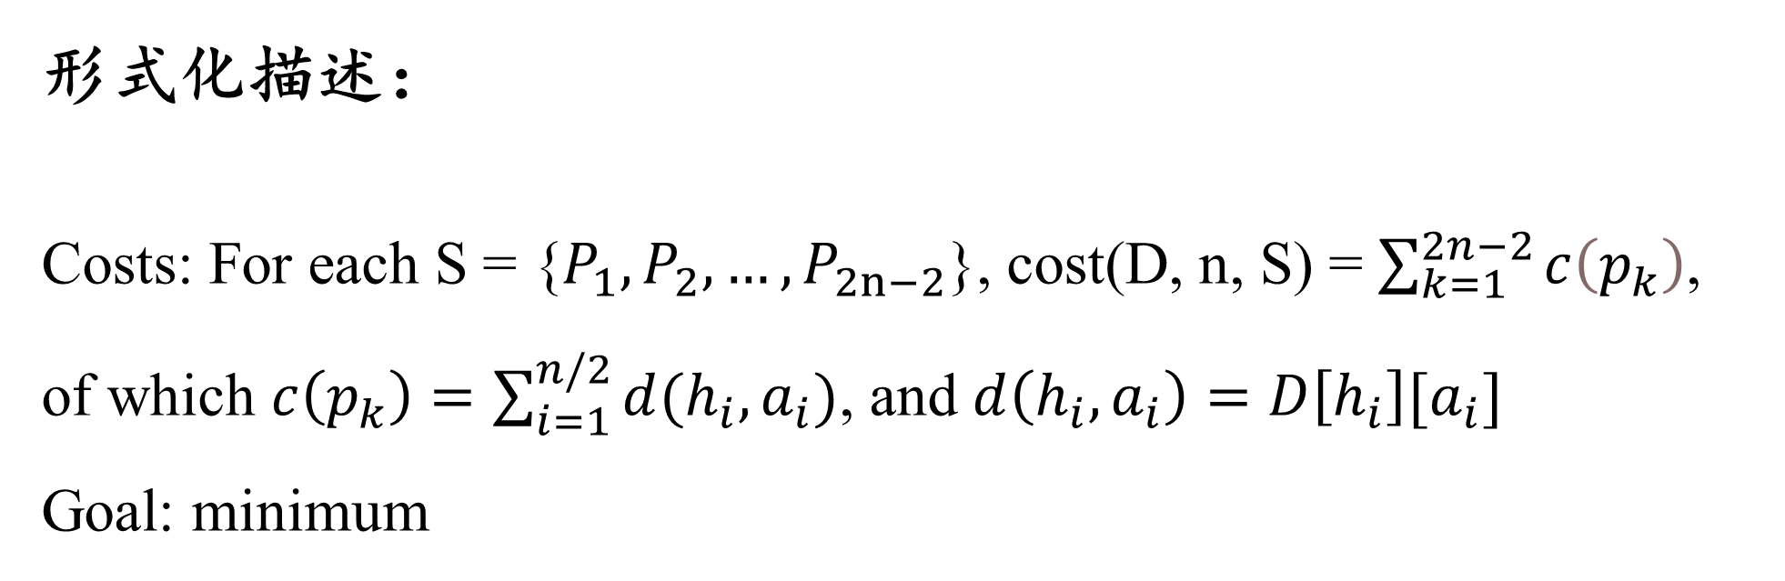
Q3
形式化描述：
Costs: For each S = {$P_{1}, P_{2},…,P_{2n−2}$}, cost(D, n, S) = $\sum_{k=1}^{2n−2}{c\left(p_{k}\right)}$,
of which $c\left(p_{k}\right)=\sum_{i=1}^{n/2}{d(h_{i},a_{i})}$, and $d\left(h_{i},a_{i}\right)=D\left[h_{i}\right][a_{i}]$
Goal: minimum

Slide 17
Q4
问题引入：
The Maximum Diversity (MD) problem is the process of selecting a subset of elements where the diversity among selected elements is maximized. Several diversity measures were already studied in the literature, optimizing the problem considered in a pure mono-objective approach.

Slide 18
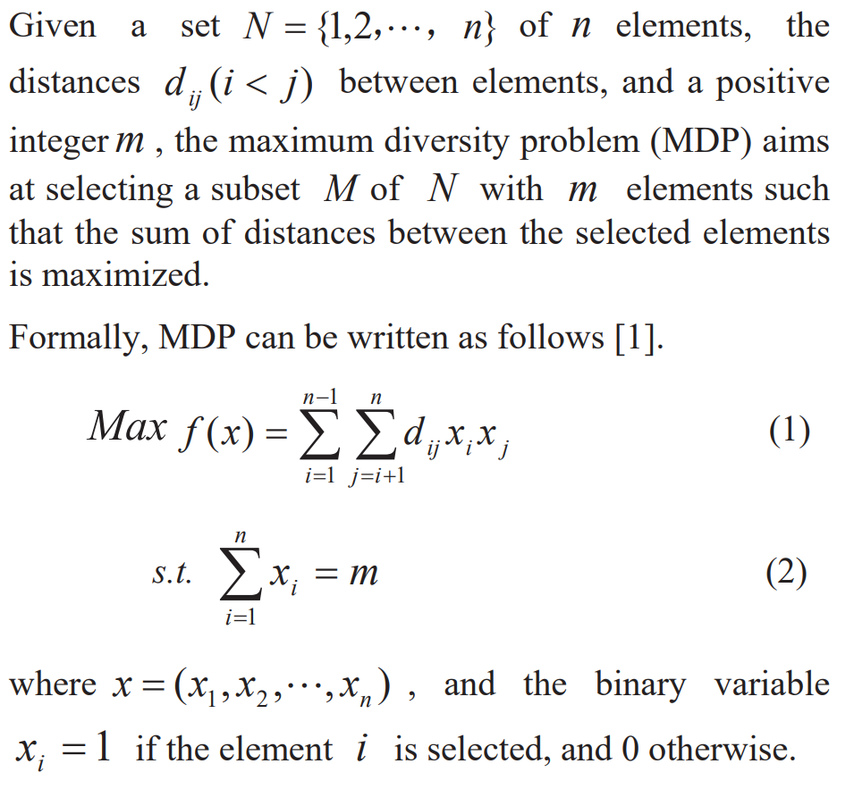
Q4
我们选择特定的一种差异性的度量标准：
距离

Slide 19

Q4
形式化描述：
Input: A set N ={1,2,…,n} of n elements, a positive integer m
the distances $d_{ij}\left(i<j\right),i,j=1,2,…,n$
Constraints: an array $X=(x_{1},x_{2},…,x_{n})$ , make $\sum_{i=1}^{n}{x_{i}}=m$,
the binary variable $x_{i}=1$ if the element $i$ is selected,
and 0 otherwise

Slide 20
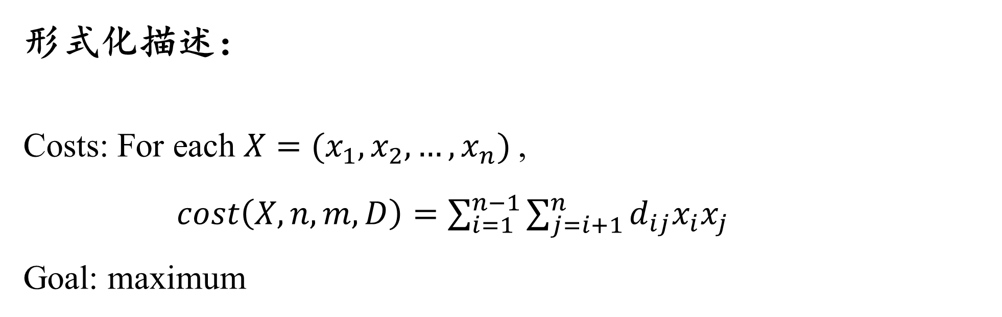
Q4
形式化描述：
Costs: For each $X=(x_{1},x_{2},…,x_{n})$,
$cost\left(X,n,m,D\right)=\sum_{i=1}^{n−1}{\sum_{j=i+1}^{n}{d_{ij}x_{i}x_{j}}}$
Goal: maximum

Slide 21
Thanks!

