Slide 1

MST的变体问题
顾鹏 匡亚明学院
221240087

Slide 2
目录：
一、最小瓶颈生成树（minimum bottleneck spanning tree）
1.适用场景
2.形式化描述
3.解决方案
二、最大生成树
1.适用场景
2.形式化描述
3.解决方案

Slide 3
Part 01 MBST

Slide 4
适用场景
问题场景：
In mathematics, a minimum bottleneck spanning tree (MBST) in an undirected graph is a spanning tree in which the most expensive edge is as cheap as possible. A bottleneck edge is the highest weighted edge in a spanning tree. A spanning tree is a minimum bottleneck spanning tree if the graph does not contain a spanning tree with a smaller bottleneck edge weight. For a directed graph, a similar problem is known as Minimum Bottleneck Spanning Arborescence (MBSA).

Slide 5
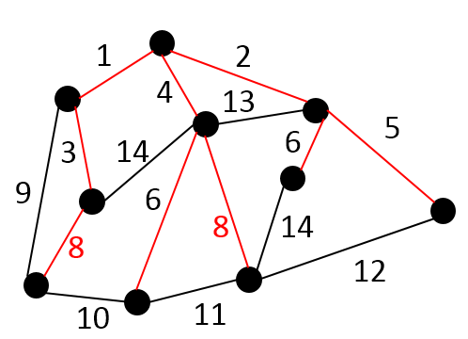
形式化描述
Undirected graphs
In an undirected graph G(V, E) and a function w : E → R,
let S be the set of all spanning trees Ti.
Let B(Ti) be the maximum weight edge for any spanning tree Ti.
We define subset of minimum bottleneck spanning trees S′ such that for every Tj ∈ S′ and Tk ∈ S we have B(Tj) ≤ B(Tk) for all i and k.
The graph on the right is an example of MBST, the red edges in the graph form a MBST of G(V, E).

Slide 6
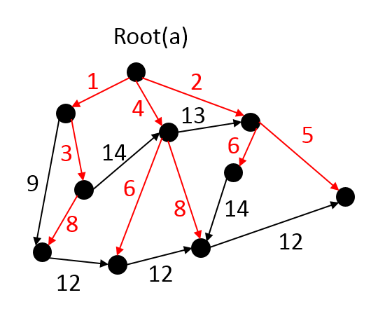
形式化描述
Directed graphs
An arborescence of graph G is a directed tree of G which contains a directed path from a specified node L to each node of a subset V′ of V \{L}. Node L is called the root of arborescence. An arborescence is a spanning arborescence if V′ = V \{L}. MBST in this case is a spanning arborescence with the minimum bottleneck edge. An MBST in this case is called a Minimum Bottleneck Spanning Arborescence (MBSA).
The graph on the right is an example of MBSA, the red edges in the graph form a MBSA of G(V, E).

Slide 7
解决方案
与最小生成树的关系：（性质）
最小生成树一定是最小瓶颈生成树，但最小瓶颈生成树不一定是最小生成树

Slide 8
解决方案
Camerini's algorithm for undirected graphs
算法概述：
It half divides edges into two sets.
The weights of edges in one set are no more than that in the other. If a spanning tree exists in subgraph composed solely with edges in smaller edges set, it then computes a MBST in the subgraph, a MBST of the subgraph is exactly a MBST of the original graph. If a spanning tree does not exist, it combines each disconnected component into a new super vertex, then computes a MBST in the graph formed by these super vertices and edges in the larger edges set. A forest in each disconnected component is part of a MBST in original graph. Repeat this process until two (super) vertices are left in the graph and a single edge with smallest weight between them is to be added. A MBST is found consisting of all the edges found in previous steps.

Slide 9
解决方案
Camerini's algorithm for undirected graphs
算法概述：
它将边缘分成两组。一组中边的权重不大于另一组的边的权重。如果生成树存在于仅由较小边集中的边组成的子图中，则它会计算子图中的 MBST，子图的 MBST 正好是原始图的 MBST。如果生成树不存在，它将每个断开连接的组件组合成一个新的超级顶点，然后在由这些超级顶点和较大边集中的边形成的图中计算 MBST。每个断开连接的组件中的林是原始图形中 MBST 的一部分。重复此过程，直到图形中留下两个（超级）顶点，并且要添加它们之间权重最小的一条边。将找到由在前面步骤中找到的所有边组成的 MBST。

Slide 10
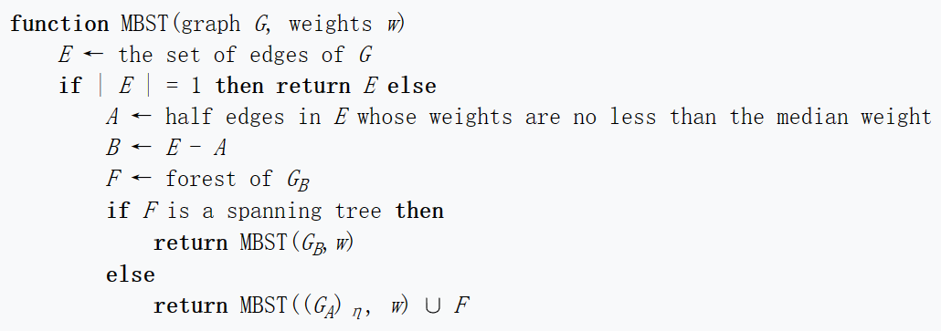
解决方案
Camerini's algorithm for undirected graphs

Slide 11
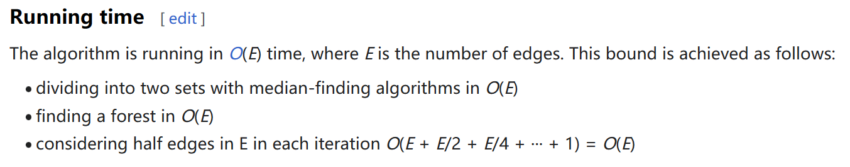
解决方案

Slide 12
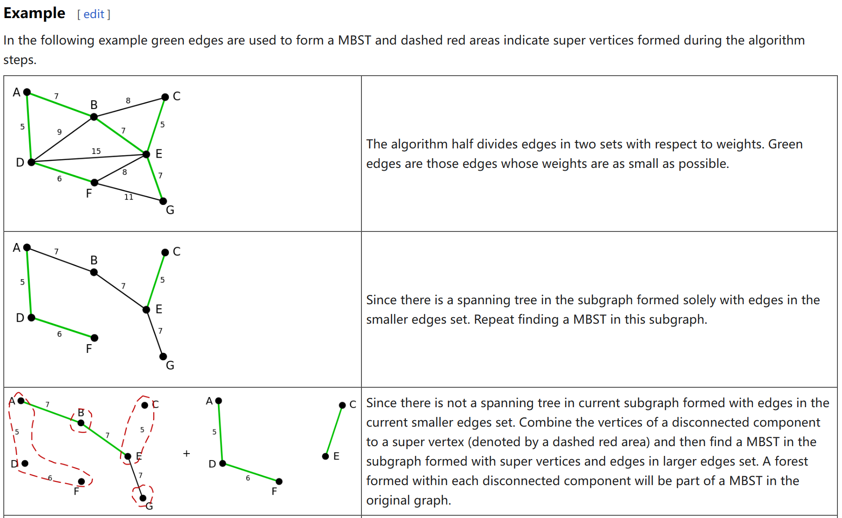
解决方案

Slide 13
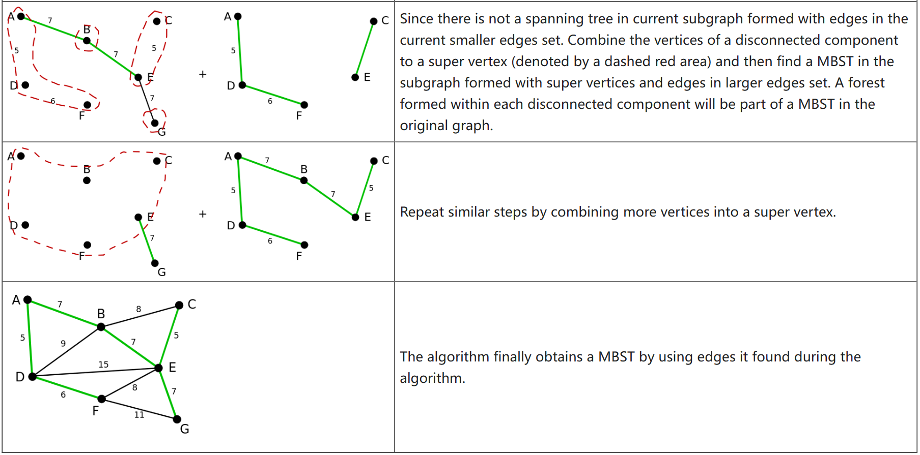
解决方案

Slide 14
Part 02 最大生成树

Slide 15
适用场景
一个带权图的最大生成树，就是原图中边的权值和最大的生成树，所以适用场景同最小生成树，都是带权无向图

Slide 16
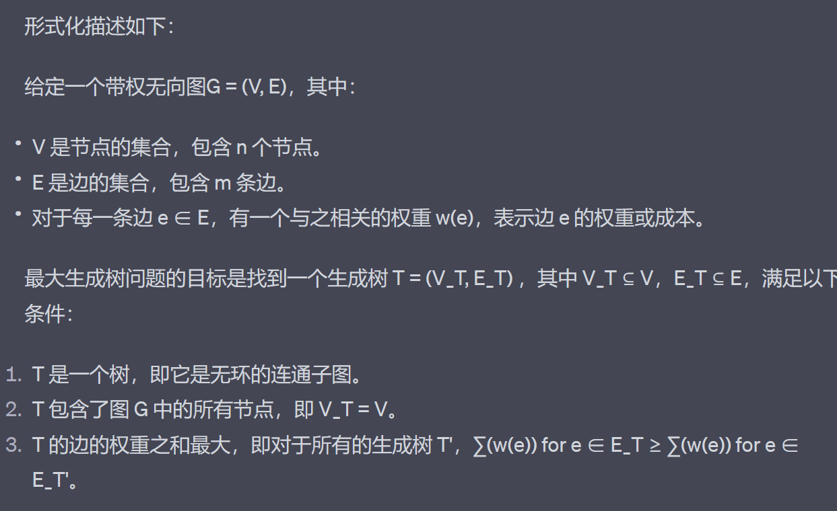
形式化描述

Slide 17
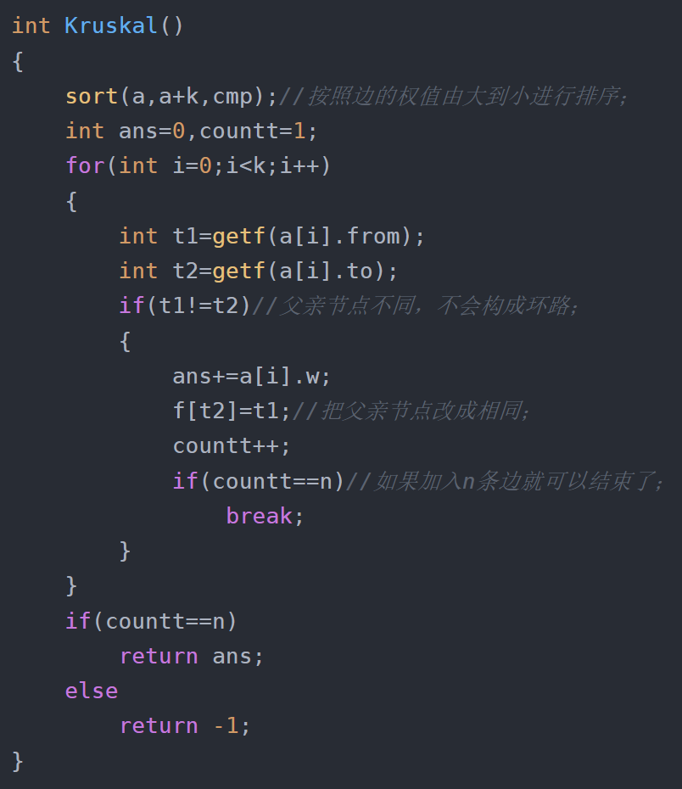
解决方案
和最小生成树好像很像？
哪里不一样呢？
其实就是第一行sort函数的排序规则变成了由大到小，那么选取边的时候就是优先选择大权重的边，就可以生成最大生成树了

Slide 18
解决方案
为什么这样就能保证算法的正确性呢？
其实和最小生成树的证明同理，不过在这里我们可以给出另一种易懂的思路，我们可以给每个边reweight。任意一条边，假设权重为x，那么我们对这条边重新赋值为inf-x，其中inf是所有边相同的一个非常大的值，那么对现在的新图跑一次Kruskal来找出最小生成树，然后生成的最小生成树其实就是原图中的最大生成树，而整个过程我们的reweight并未破坏边权的偏序关系，只是改变了他们的方向，所以Kruskal算法可以修改一个排序规则后正确地找出最大生成树，相当于做了一次reweight

Slide 19
Thanks

