Slide 1

独立、覆盖的扩展优化问题
顾鹏 匡亚明学院
221240087

Slide 2
目录：
最小权完美匹配问题 (Minimum-Weight Perfect Matching)
  1.1 问题引入
  1.2 形式化语言
  1.3 算法
最小权顶点覆盖问题 (Minimum Weighted Vertex Cover Problem)
  2.1 形式化语言
  2.2 算法
  2.3 实例

Slide 3
Part 01
Minimum-Weight Perfect Matching problem

Slide 4
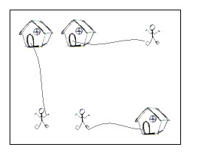
问题引入
On a grid map there are n little men and n houses. In each unit time, every little man can move one unit step, either horizontally, or vertically, to an adjacent point. For each little man, you need to pay a $1 travel fee for every step he moves, until he enters a house. The task is complicated with the restriction that each house can accommodate only one little man.
Your task is to compute the minimum amount of money you need to pay in order to send these n little men into those n different houses. The input is a map of the scenario, a '.' means an empty space, an 'H' represents a house on that point, and am 'm' indicates there is a little man on that point.

Slide 5
问题引入
这是POJ-2195题目，主要考察二分图带权匹配和最小费用最大流等知识点，简单来说题意就是：
在一个地图上，有一些房子和人，一个人只能进一个房子，一个房子也只能进去一个人，房子数等于人数，现在要让所有人进入房子，求所有人都进房子最短的路径。
显然这是二分图问题，下面我们通过这个例子来描述非二分图的最小权完美匹配问题及其算法

Slide 6
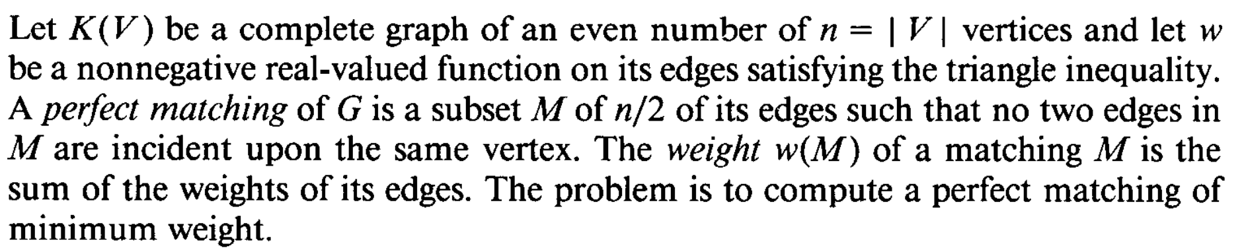
形式化语言
input
constraints
cost
goal

Slide 7
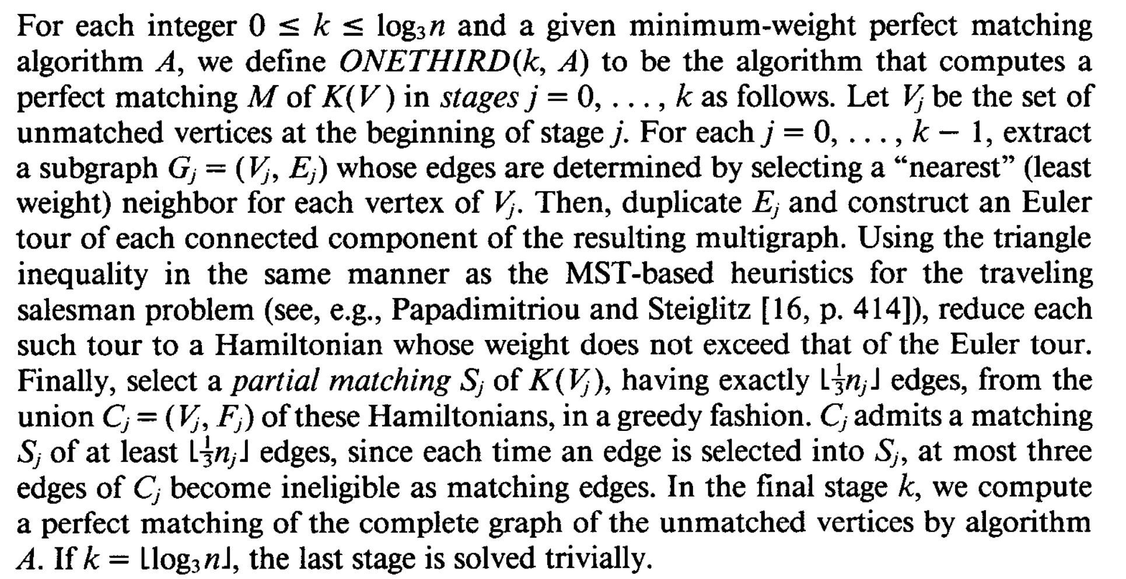
算法
算法思想

Slide 8
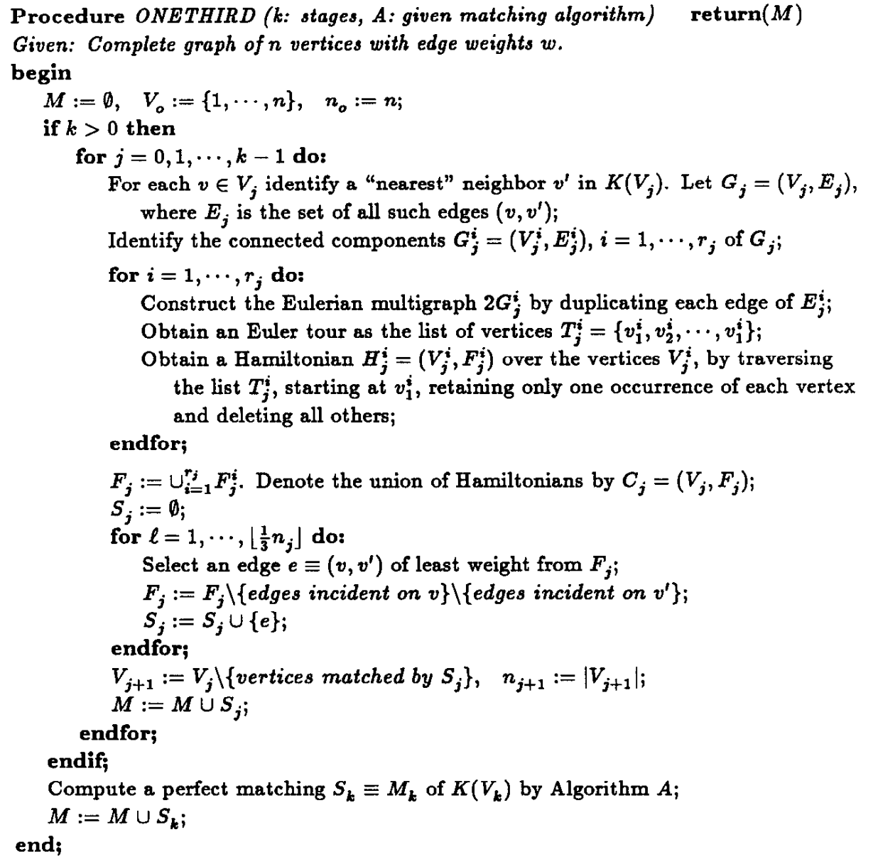
算法
伪代码

Slide 9
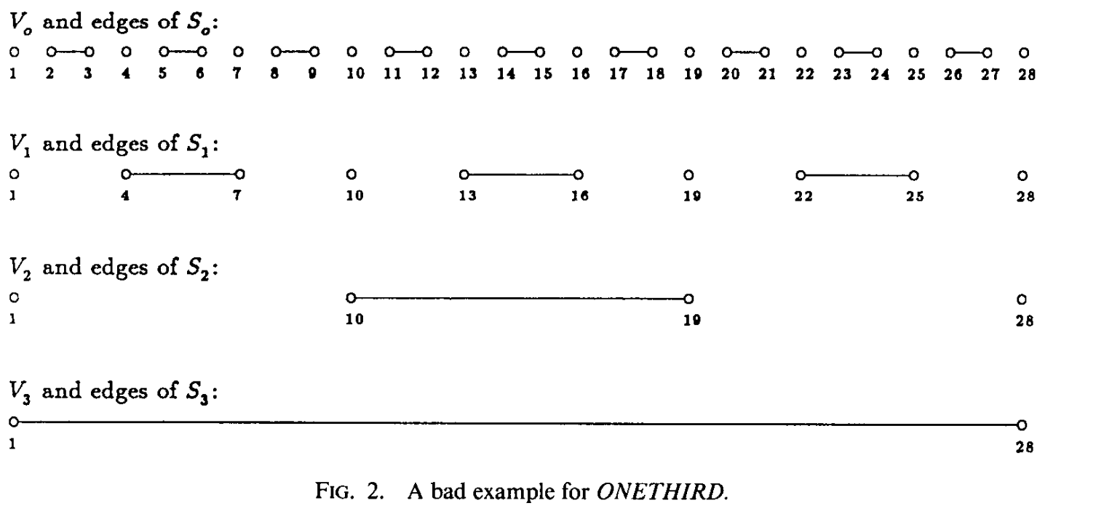
算法

Slide 10
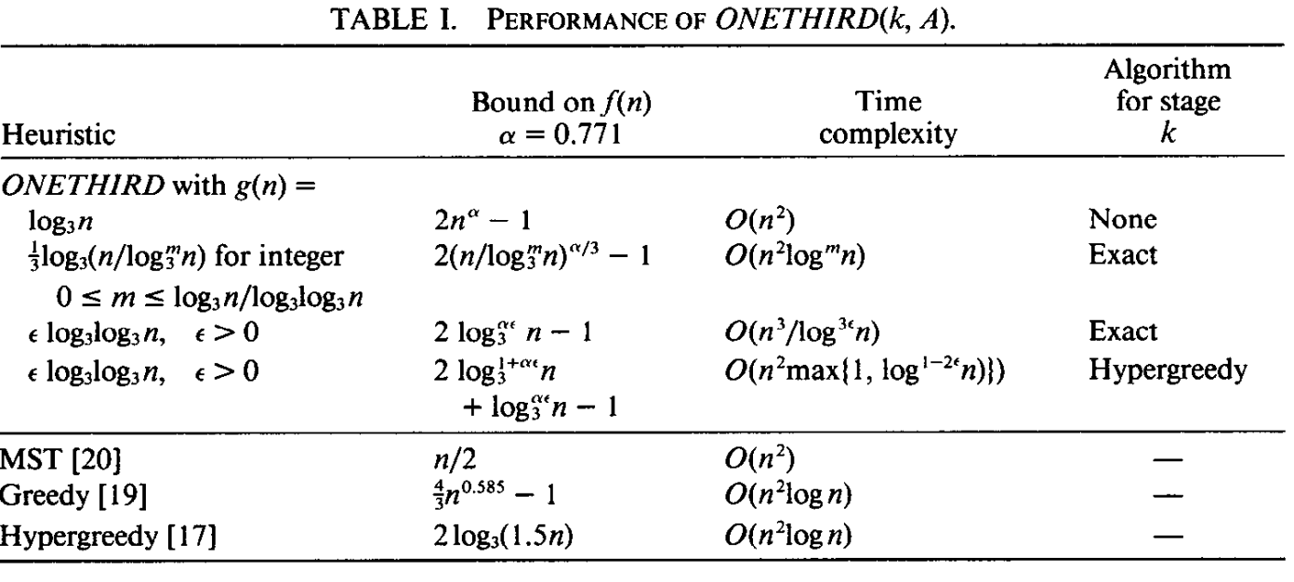
算法

Slide 11
Part 02
Minimum Weighted Vertex Cover Problem

Slide 12
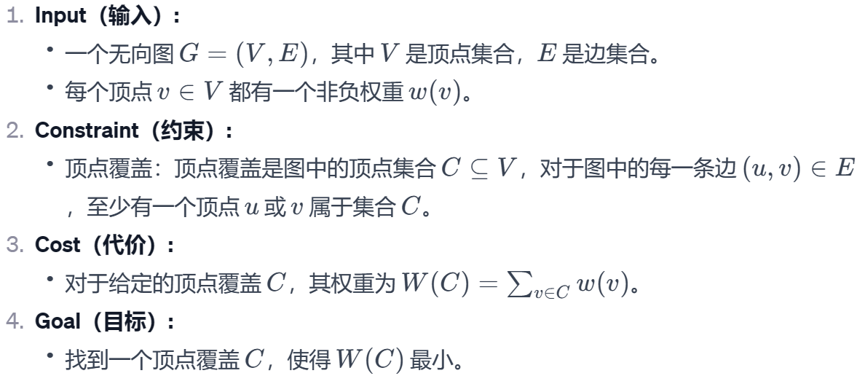
形式化语言

Slide 13
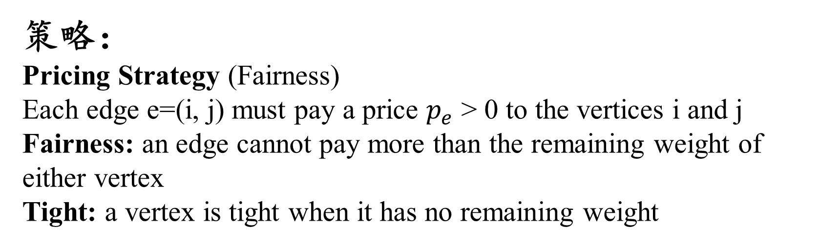
算法
The problem is NP-Complete but this algorithm is a polynomial-time 2-approximation algorithm.
策略：
Pricing Strategy (Fairness)
Each edge e=(i, j) must pay a price $p_{e}$ > 0 to the vertices i and j
Fairness: an edge cannot pay more than the remaining weight of either vertex
Tight: a vertex is tight when it has no remaining weight

Slide 14
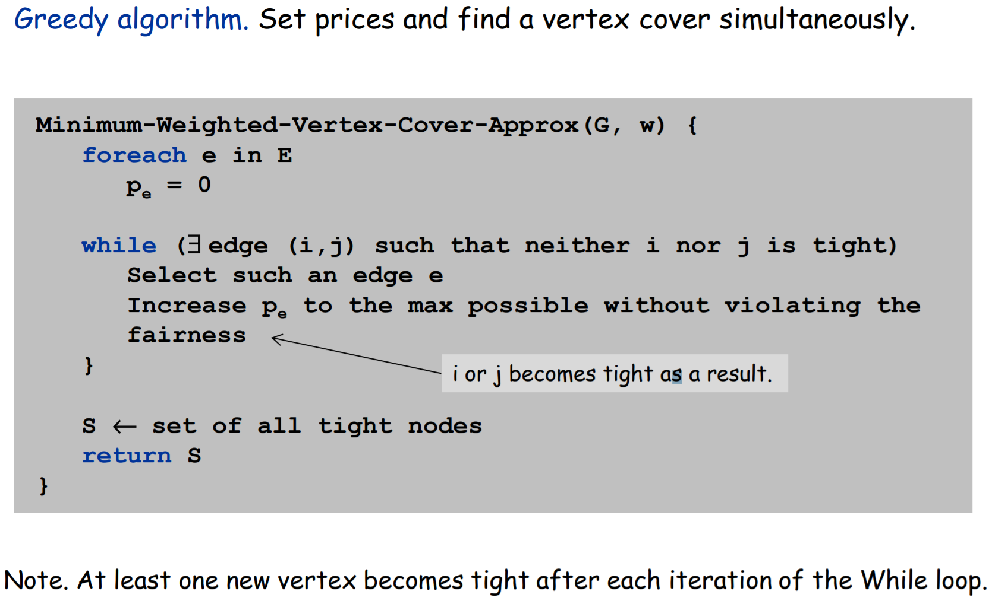
算法

Slide 15
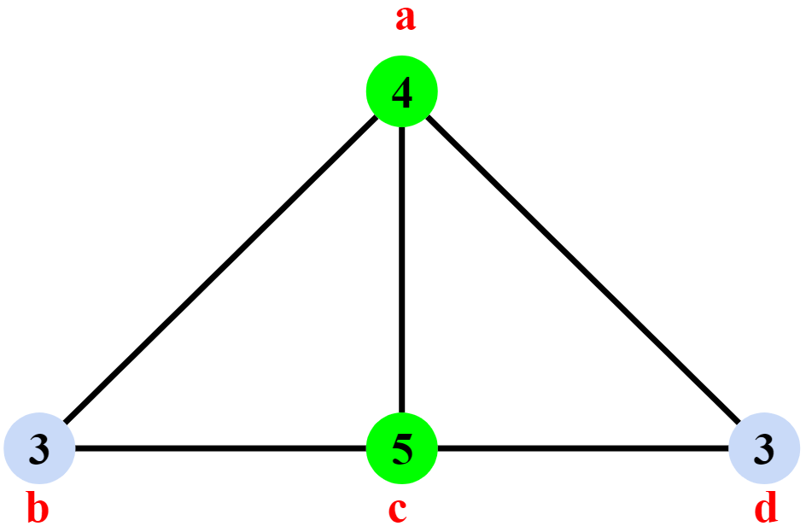
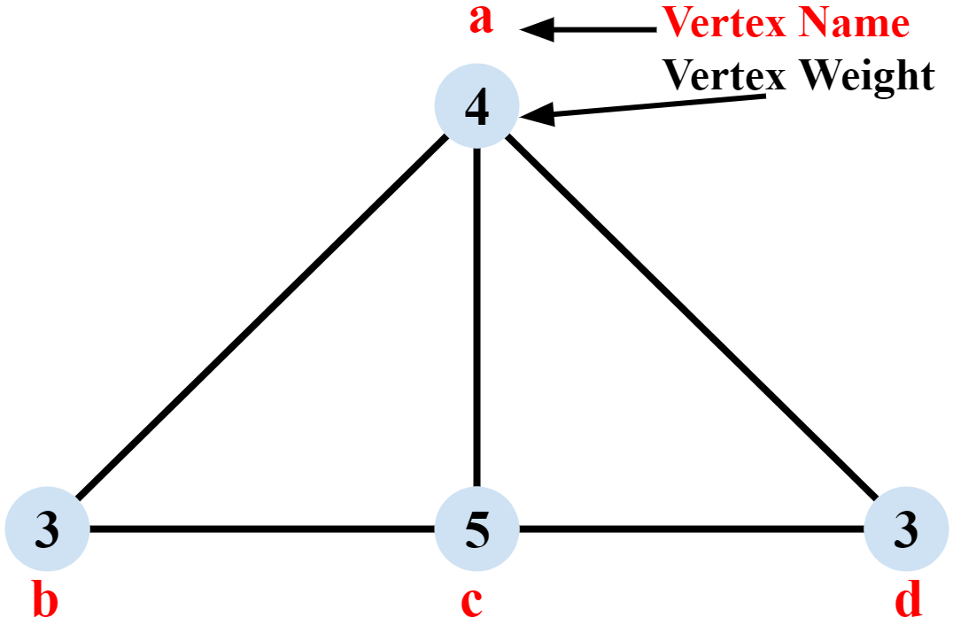
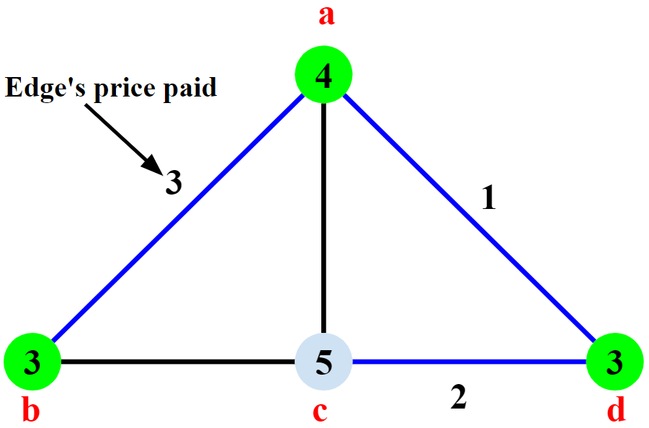
实例
Optimal
Input graph
Algorithm’s result

Slide 16
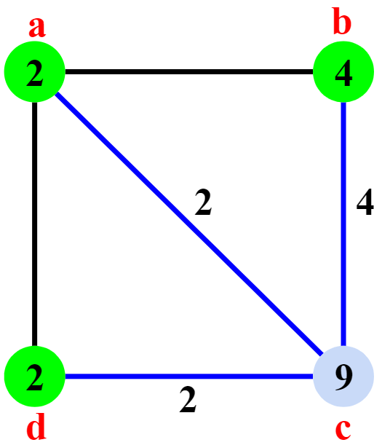
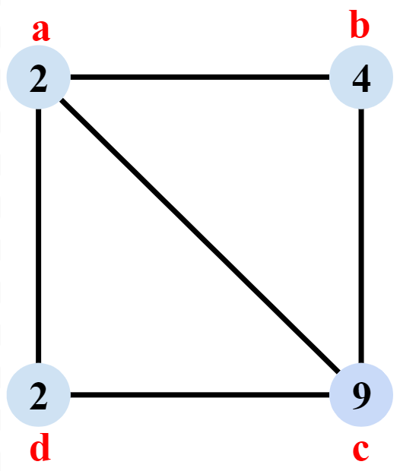
实例
Optimal
Input graph
Algorithm’s result

Slide 17
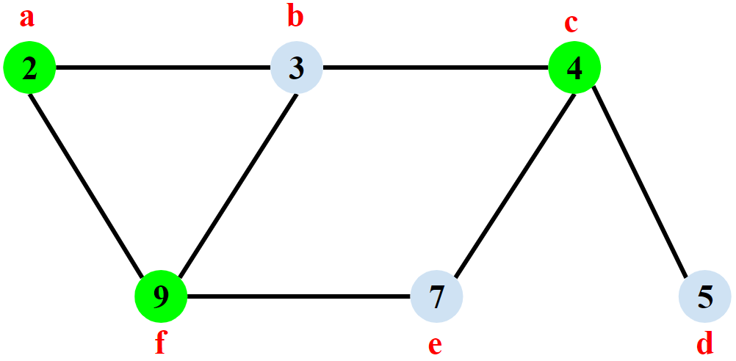
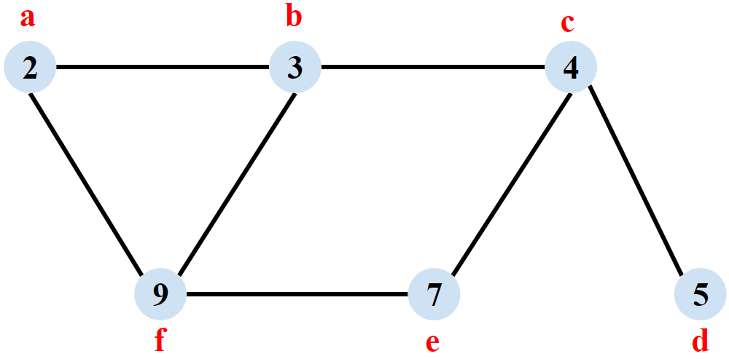
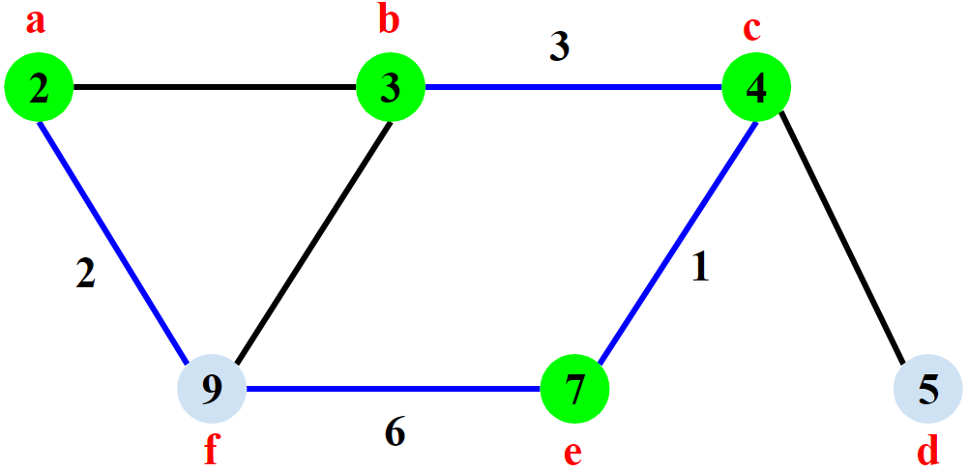
实例
Optimal
Input graph
Algorithm’s result

Slide 18
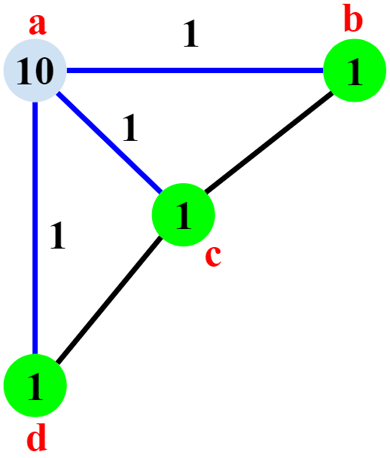
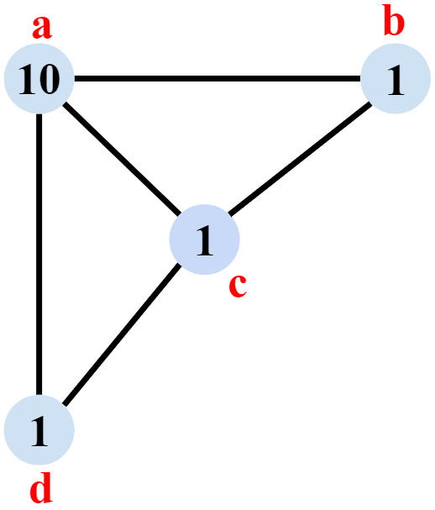
实例
Optimal
Input graph
Algorithm’s result

Slide 19
Thanks

